Slide 1
NASA CMS uncertainty working group
Active members: Participants: Chris Badurek, David Baker, Nicolas Bousserez, Jim Collatz, Sangram Ganguly, Robert Kennedy, Dimitris Menemenlis, John Miller, Steve Pawson,
`

Slide 2
Ocean State
Land State
“Uncertainty”
Ocean/air flux
Ocean/Land flux
Land/air flux
Notes:
Overall goal: When we talk about uncertainty in these different domains, are we talking about the same thing?

Slide 3
If we were all talking about the same thing, then we could put all of our results together and everything should overlap!
Observation
What is uncertainty here?
Model
Map of state or flux
Data
Propagation
Map 2 of state or flux
Notes:
The basic notion: We are making estimates at locations where we have no observations.

Slide 4
Understand CMS projects
Online Survey
https://docs.google.com/spreadsheet/ccc?key=0AsSSZURmMDWwdEl2eWY0WmpkYVlMdmhLV2ZGc25CX2c#gid=0
Notes:
We initiated a survey within CMS for projects to self-report their own goals/domain/approach to use uncertainty.

Slide 5
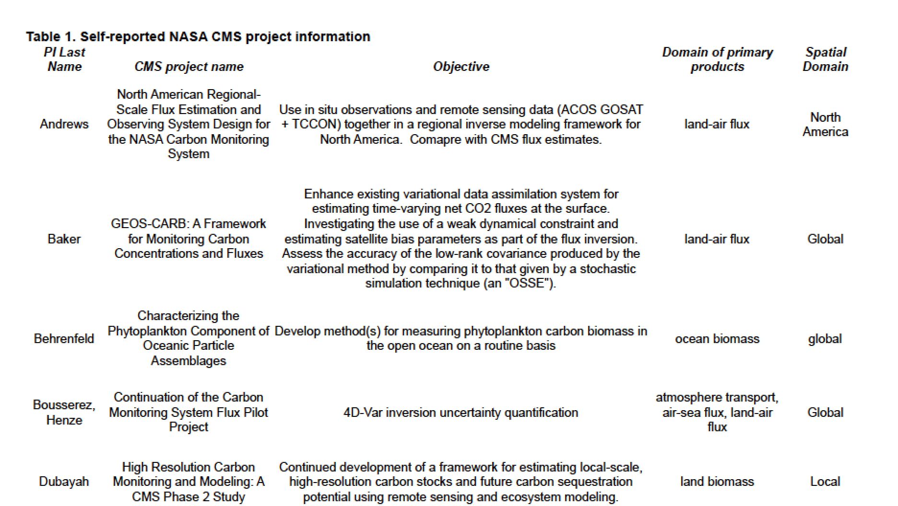
ETC.
Notes:
Example of the self-reported table…

Slide 6
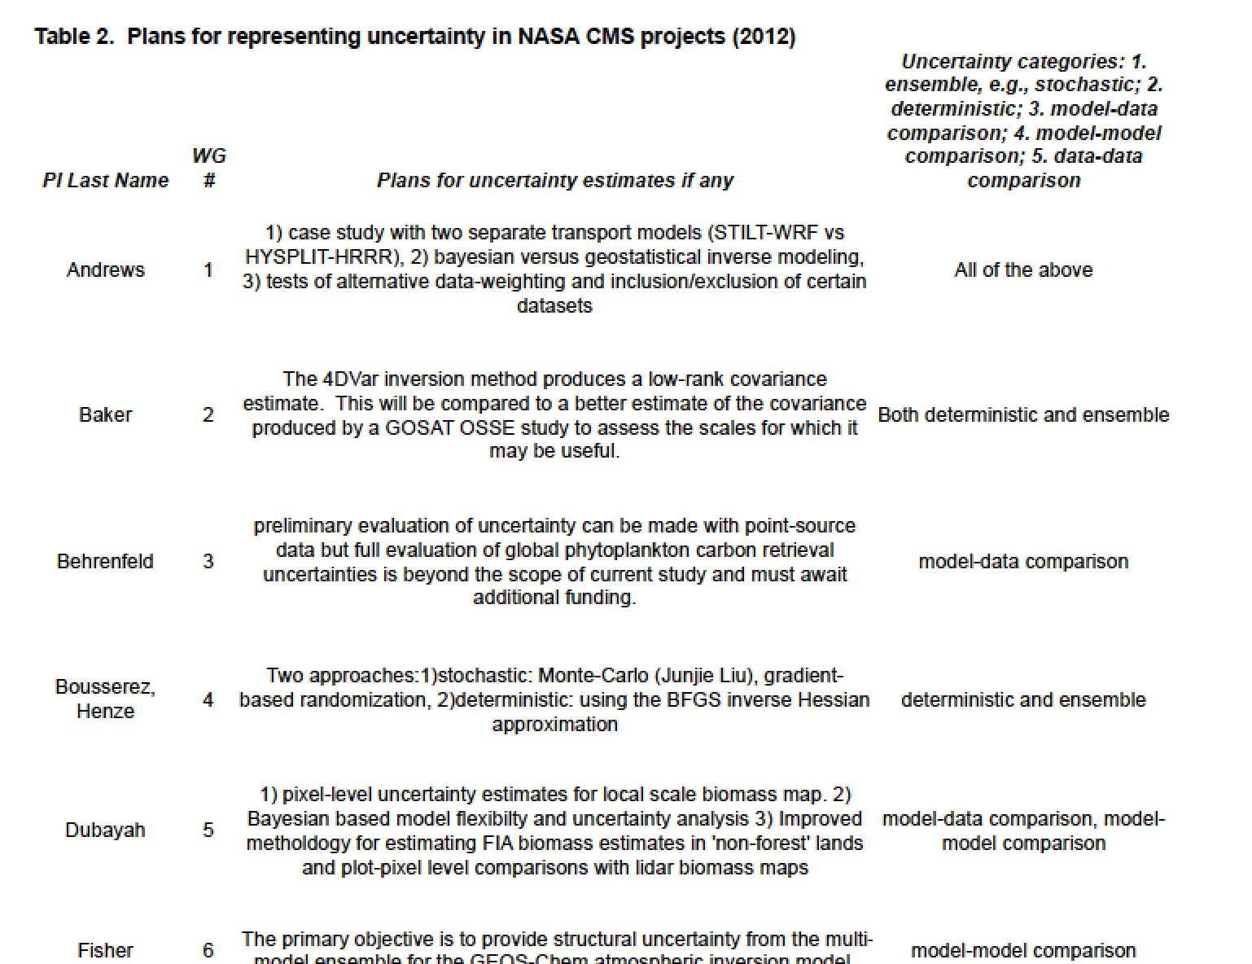

Slide 7
Types of uncertainty
Notes:
From that table and our own knowledge within the team, we came up with a simple framework for characterizing uncertainty.

Slide 8
3. Model-data comparison
1. Deterministic
2. Stochastic/Ensemble
4. Model-model comparison
Models and data are both wrong
Models are correct – errors come from measurements and the initial guess of the state.
5. Data-Data comparison

Slide 9
* Numbers correspond to project IDs in briefing material appendix

